Slide 1
The Sunshine Sharing Hour
With Steven Horne, DNM, DHS, RH(AHG)
Tuesday, December 17, 2019

Slide 2
Shining a Light on the Darkness of Depression

Slide 3
Depression Stats
7% of the American population(about 17 million people) have a major depressive episode each yea
About 10% of all doctor and hospital visits are about depression
About 12% of the population are taking antidepressants each month
Drug prescriptions for depression have increased by over 400% in the last two decades

Slide 4

Occasional Depression is Normal
Just about everyone will become depressed at one time in their lives
It’s perfectly natural to feel depressed when
  We’ve lost a loved one
  Have suffered a major setback in life, such as the loss of a job or home
  Have been under stress for an extended period of time
Most of the time depression is temporary and we’ll get over it naturally given time

Slide 5
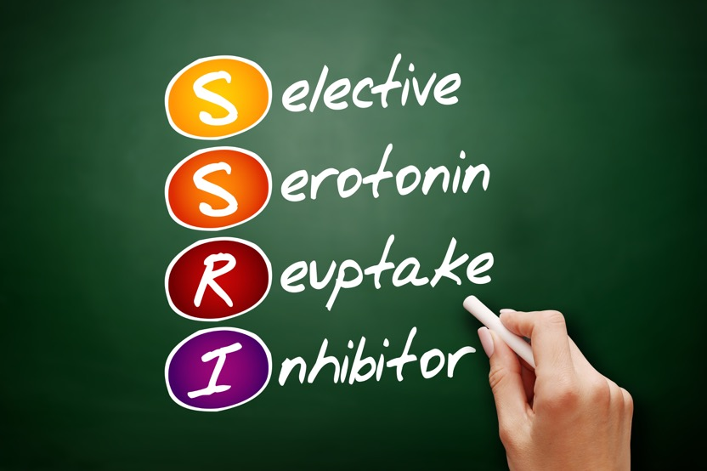
The Drug Problem
Today, most depression is treated with drugs
The most common drugs are SSRIs (Selective Serotonin Reuptake Inhibitors)
Originally approved for severe depression they are now being prescribed for
  Mild to moderate depression
  Anxiety
  Sleep disturbances
  Neuropathic pain

Slide 6
Serotonin Drugs
SSRIs—Selective Serotonin Reuptake Inhibitors (inhibit serotonin reuptake, may also increase GABA responses)
  Fluoxetine (Prozac), Paroxetine (Paxil, Seroxat), Sertraline (Zoloft, Lustral), Citalopram (Celexa), Excitalopram (Lexapro, Cipralex), Fluvoxamine (Luvox)
SMS—Serotonin Modulators and Stimulators
  Vilazodone (Viibryd), Vortioxetine (Brintellix)
SARIs—Serotonin Antagonists and Reuptake Inhibitors (block serotonin receptors)
  Etoperidone (Axiomin, Etonin) and Trazodone (Desyrel)

Slide 7
SSRI Side Effects
A 2009 study of 700 patients taking SSRIs found the following side effects:
56% experienced decreased sexual functioning
  drowsiness (53%)
  gained weight (49%)
  dry mouth (19%)
  insomnia (16%)
  fatigue (14%)
  nausea (14%)
  light-headedness (13%)
  tremor (12%)

Slide 8
Black Box Warnings
The FDA itself issued a black box warning in 2004
  SSRIs were associated with suicidal thoughts and behaviors
The warning was updated in 2007
  Highest risk is for young adults between the ages of 18 and 24 as well as children under 18
Suicide rates have gone up 30% in the past two decades
Suicide is now the 10th leading cause of death in the United States and the 2nd leading cause of death among young people age 15-29

Slide 9
Other Potential SSRI Side Effects
Mania and psychosis
Increased agitation and rest;essness
Increased aggression and violent behavior
People on SSRIs are more likely to fight with spouses, bosses and even police, causing problems with work, marriage and other conflicts
SSRIs may dull feelings of empathy and concern for others
There may also be increases in alcohol and substance abuse
http://www.drugawareness.org/ssri-facts/ssri-meds/

Slide 10
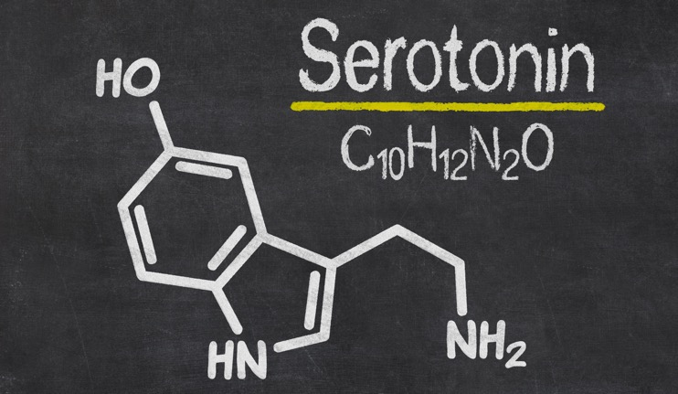
Understanding Serotonin
Regulates carbohydrate cravings, digestion
Regulates sleep cycle
Affects pain tolerance
Promotes assertive behavior and the drive for self-esteem
90% of serotonin receptors are in the gut, 8% in the blood and only 2% in the brain

Slide 11
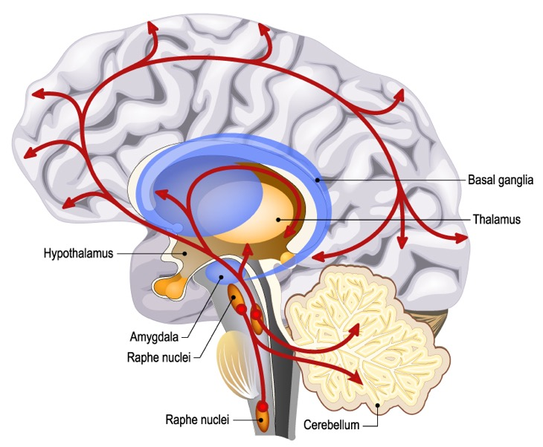
Serotonin Producing Neurons
Located in the raphe nuclei, the midline of the brain stem
Project upwards into all parts of the brain and downward into the spinal column
Have a regular, slow spontaneous level of activity during the day that varies little
Slow down when you sleep, shut down when you dream

Slide 12
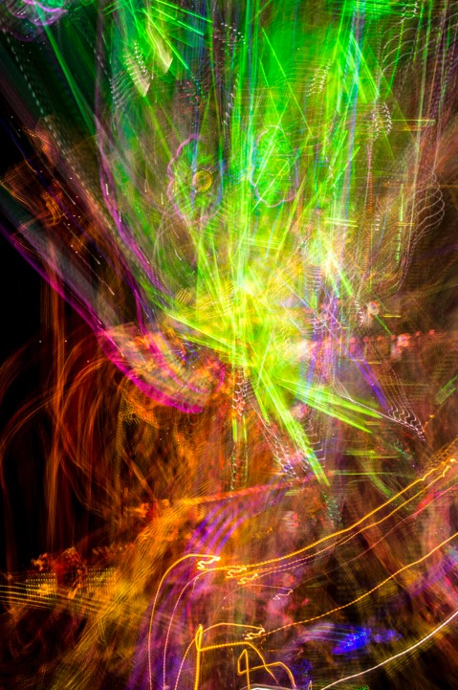
Serotonin and LSD
LSD binds to a variety of serotonin receptors slowing their rate of firing
This induces hallucinations that last well beyond the time LSD stops interfering with serotonin
Remember that serotonin is also inhibited when we are dreaming
Ergot fungus and psilocybin from certain mushrooms has a similar effect

Slide 13

Serotonin and Status
Research shows that serotonin neurons are involved in our drive for status and achievement
Serotonin neurons push us to get our needs met
People who have achieved a high degree of status have higher levels of serotonin
Psychologist Jordon Peterson says this is even true for lobsters
When a dominant lobster is defeated by a stronger lobster, the loser suffers a loss of serotonin
Given SSRIs, the losing lobster may return and fight again
So, SSRIs are linked with increased aggression

Slide 14
SSRIs and Mass Shootings

Slide 15
The SSRI Link
There has been a large increase in mass shootings
Some researchers have linked this with increasing use of antidepressants like SSRIs
There is evidence that most, if not all, of these shooters have been using drugs that alter brain chemistry like SSRIs

Slide 16

Violent Mice
Mice with a mutation that causes their brains to be flooded with an excess of serotonin (Tg8 mutation) have fierce tempers
  Mutant Mice May Hold Key To Human Violence–An Excess Of Serotonin, A Chemical That Helps Regulate Mood And Mental Health, Causes Mayhem by Jean Chen Shih from http://www.drugawareness.org/ssri-facts/ssri-meds/

Slide 17
Practical Insights on Serotonin and Depression
Do You Have a Biochemical Imbalance?
  https://youtu.be/ARZ2Wv2BoFs
How to Help a Suicidality Depressed Person
  https://youtu.be/t7OPWRqjaSQ

Slide 18
Attitude and Serotonin
Serotonin neurons are located at the base of the skull
Note that we slump forward and hang our head when we feel defeated
Throwing our shoulder’s back, lifting our head and determining to do something worthwhile in life helps naturally increase serotonin activity

Slide 19
Weaning Off Antidepressants
The brain adjusts the to the presence of SSRIs, which means that the balance of the neurotransmitters changes when the dose is altered.
The daily dose should be reduced slowly over the course of many months, or even years
Save off small amounts of the pills, don’t cut them
Slowly reduce the dose over months or even a year
Ideally this should be done under professional supervision
One can use the Chinese Qi Regulating formula or small amounts of 5-HTP as the dose reduces

Slide 20
Fighting Depression Naturally

Slide 21
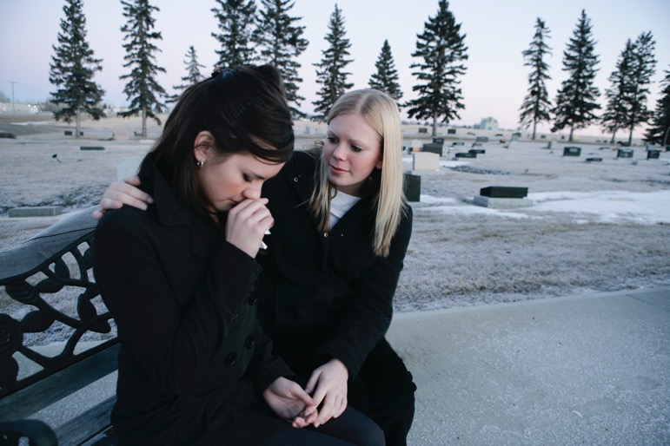
Depression is Primarily Psychological, Not Chemical
Most of the time, the cause of depression isn’t physical
People get depressed when they:
  Suffer loss and experience grief,
  Are under excessive stress
  Feel life has no higher meaning
  Are lonely and alienated from others
Depressed people usually need assistance in learning how to cope with their problems
  Besides professional counselors, pastors, ministers and even good friends may help
  Counseling has the same success rate as drugs without the potential side effects.

Slide 22
The Five Stages of Grieving
There are five stages of grieving
  Denial and isolation
  Anger
  Bargaining
  Depression
  Acceptance
Not everyone experiences all five stages
The stages do not appear in any particular order
Depression is a normal part of the grieving process and is not a disease

Slide 23

Self-Care is Important
Self-care is important in overcoming depression
Eat a healthier diet
  Fresh fruits and vegetables
  Adequate protein intake
Exercise
  Try walking for 30-60 minutes a day in the fresh air and sunshine will help
Get a good night’s sleep

Slide 24
Try Some Basic Supplements
Anti-Stress Vitamin Supplement
  B-Complex
  Vitamin C
  Nervine and adaptagenic herbs
Omega-3 Essential Fatty Acids
Algae Supplement
  Spirulina, Blue Green Algae, Chlorella
Chinese Qi Regulating Formula

Slide 25
Addressing Specific Issues in Depression

Slide 26
Inflammation
Recent research suggests that there is a link between chronic inflammation and depression
Inflammation is not the direct cause of depression, but reducing chronic inflammation eases depression
Signs of chronic inflammation
  General aches and pains
  Dark red or purplish colored tongue
  High levels of C-reactive protein
Anti-inflammatory remedies
  Formulas with turmeric, boswelia, mangosteen and willow bark
  Curcumin and/or turmeric
  Omega-3 Essential Fatty Acids

Slide 27
Remedies for Grief and Sadness
Essential Oils
  Rose
  Bergamot
  Pine
  Helychrisum
Flower Essences
  Self-heal
  Love-lies-bleeding
  Bleeding heart
  Borage
  California Wild Rose
  Rescue or Distress Remedy

Slide 28
Stress and Burnout
Symptoms of stress-related depression
  High anxiety and nervousness
  Severe fatigue
  Loss of interest in life
  Low libido
  Feeling “I just can’t cope anymore!”

Slide 29

Stress-Related Depression
Adaptagens (Schizandra, Eleuthero, Korean Ginseng)
Kava Kava
Adrenal Glandulars
B-Complex Vitamins
Chinese Fire Increasing formula
Take a vacation and get some rest
Get more sleep
Mediate and pray
Evaluate your priorities and let go of what is less important in favor of what is more important

Slide 30
Disturbed Methylation
May be involved in depression, anxiety
and mental illness
Signs of under methylation include:
  High levels of homocysteine and histamine
  A tendency to seasonal allergies
  Depression that responds favorably to SSRIs.
SAM-e aids methylation and is helpful
for depression involving undermethylation
  Studies suggest it can be effective for mild to moderate depression
  Helps mood-enhancing neurotransmitters like dopamine and serotonin
  Acts as a natural reuptake inhibitor for these neurotransmitters
  Aids liver detoxification
Over methylators do not respond well to SSRIs or Sam-e

Slide 31
Sam-e
Dr. Bressa, in a meta analysis of studies on Sam-e concludes, "The efficacy of SAM-e in treating depressive syndromes and disorders is superior to that of placebo and comparable to that of standard tricyclic antidepressants. Since it is a naturally occurring compound with relatively few side-effects, it is a potentially important treatment for depression.“
It acts on mood rapidly, most often within a few days.
SAMe has no withdrawal reaction, commonly found with antidepressants

Slide 32
Toxicity and Depression
Depression was once called melancholia and was thought to be an accumulation of black bile
Today we’d consider black bile an accumulation of toxins
More serotonin is produced in the gut than in the brain
Gut health has been linked with mood problems like anxiety and depression
When the liver isn’t detoxifying well one can become irritable, anxious or depressed

Slide 33
Age Related Depression
As a person ages, they may become depressed
This may be associated with dementia or the early stages of Alzheimer’s disease
Possible remedies:
  Ginkgo
  Ginseng
  Gotu kola
  DHA and Omega-3 EFAs

Slide 34

Female Hormones
Women who have depression associated with PMS or menopause, or post partum depression are often low in estrogen
Women who are abused may also suffer from hormone-related depression
Possible remedies include:
  Black cohosh
  Damiana
Get back in touch with your feelings and take responsibility for them

Slide 35

Male Hormones
Low levels of testosterone in men can lead to depression
Fluoride and xenoestrogens can contribute to this
Possible remedies:
  Korean Ginseng
  Damiana
  Sarsaparilla
  Zinc
Build “wins” for yourself, masculine energy needs to achieve to feel good

Slide 36
Low Thyroid
Low thyroid can create low energy levels which make a person feel mildly depressed
  Low thyroid symptoms include:
  Fatigue
  Weight problems
  Dry skin
  Low body temperature
  High cholesterol
Feeding the thyroid gland with a Hypothyroid Formula, containing herbs like kelp and dulse, may help
Ashwaganda may also be helpful

Slide 37

Working with Depression
Don’t treat it symptomatically
Get in touch with what is “getting you down”
Try to understand what you need that you are not getting and find a way to fulfill your needs in a constructive manner
Seek out help and support from others
Prayer and learning to “count your blessings” can also be helpful

Slide 38
Herbal Remedies

Slide 39
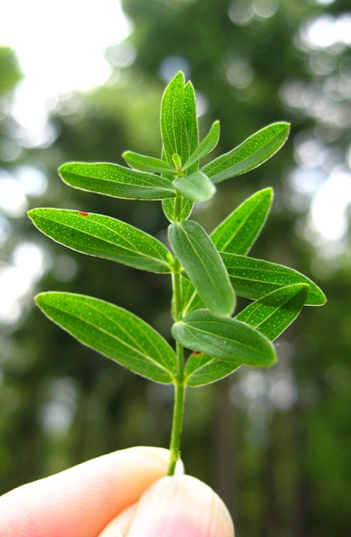
St. John’s Wort
A remedy that “brings in the light”
Helps regulate the solar plexus, the nerves which regulate digestion
Good for depression associated with digestive problems and anxiety
Helps strengthen gut instincts
Can help nightmares in children or feeling overly vulnerable
Modulates a number of neurotransmitters in the brain and reduces inflammation
Do not use with antidepressant drugs

Slide 40
Black Cohosh
Helpful antidepressant for dark, brooding emotions
Feeling like you have a black cloud over you
Feeling trapped in darkness and unable to get free
Continually getting entangled in addictive, abusive relationships
A feeling that you are spiritually struggling with the powers of darkness
Needed in very small amounts (part of a capsule, drops of a tincture or as a flower essence)

Slide 41
Damiana
Indicated for nervous exhaustion causing depression, mental fatigue, physical fatigue, poor concentration, poor sex drive
For depression in the elderly, use with rosemary or rosemary and sage
Has a nice mood elevating effect
It can help a person find something they lost somewhere on the road of life.

Slide 42
Rose
The essential oil or flower essence of rose can open the heart to ease sadness and grief
Helps a person be responsive to love and open to relationships
Works well with mimosa to comfort the heart
Works well as a flower essence with bleeding heart and love-lies-bleeding

Slide 43
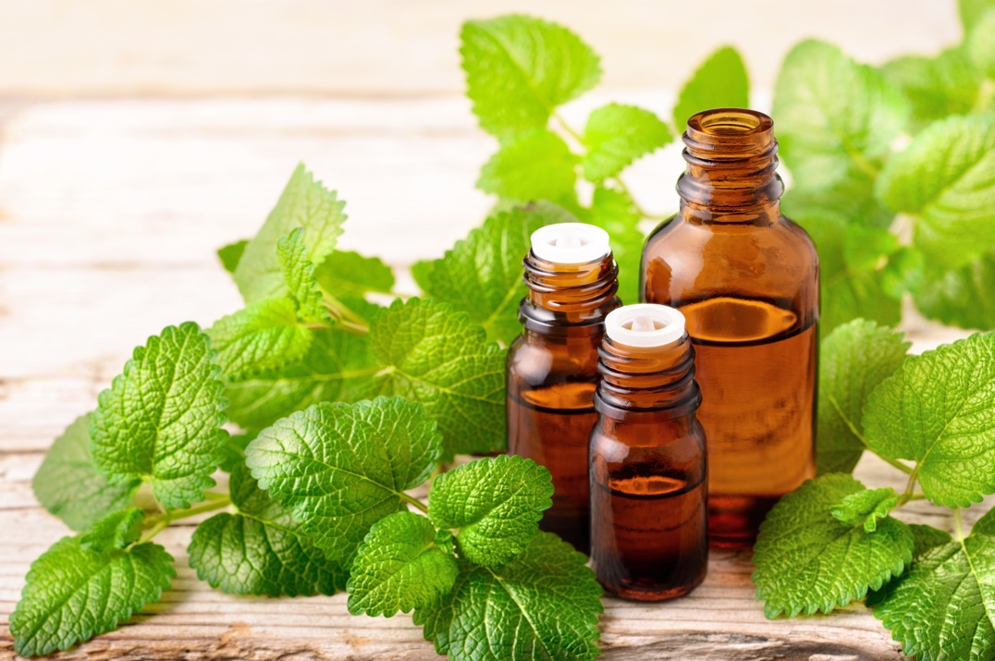
Lemon Balm
Works as a mood elevator in depression brought on by grief
Use the herb or the essential oil
Uplifting and energizing
Combines well with mimosa and/or rose for grief-related depression
Combine with St. John’s wort to treat SAD (Seasonal Affective Disorder)

Slide 44
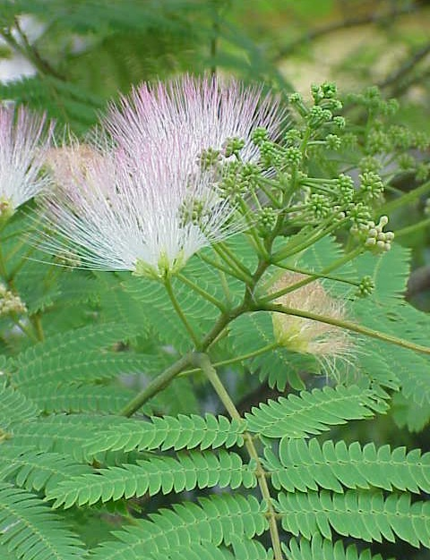
Mimosa
Calms the emotions
Opens the heart
Relieves tension
Eases bad temper
Lifts depression
Reduces insomnia and irritability
The bark has been traditionally used for general stress, depression and a broken heart
The flowers create mild euphoria and giddiness

Slide 45
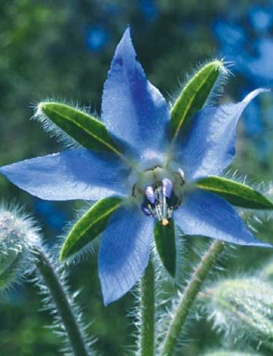
Borage
Can be used as an herb or flower essence for feeling heavy-heartedness or grief
It rebuilds the adrenals and helps people who feel their situation is hopelessly difficult
Promotes cheerful courage when facing adversity and brings out joy and playfulness
Helps a person “take heart” or have the courage to continue in spite of difficulty
Use the oil, flowers or flower essence

Slide 46
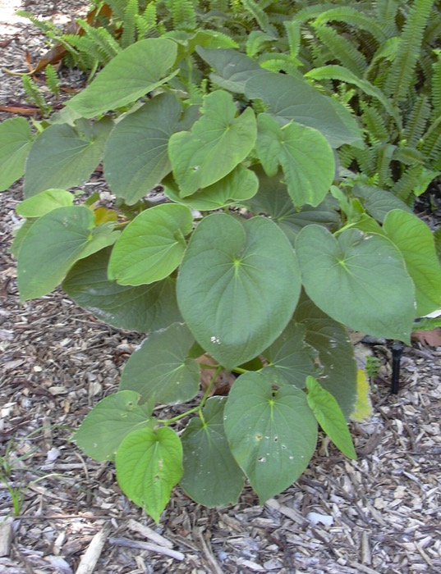
Kava Kava
Very good herb for reducing muscle tension and anxiety
Helps create a calm body with an alert mind
May be helpful for stress-related insomnia
Mildly euphoric
Can be helpful for stress brought on by chronic stress
May aid sleep by relaxing the body

Slide 47
Upcoming Education
Upcoming Member Webinars
  A Holistic Approach to Disease
    Tues, January 14, 6:00 MT – Mood Disorders: Anxiety, Depression, Mental Illness
  Sunshine Sharing Hour
    Tues, January 28, 6:00 MT – The Endocannabinoid System
No Other Classes and Events Schedules

Slide 48
Comments, Questions and Answers
Type your questions about tonight’s topic into the chat box
Product presentation to follow this Q&A

